Slide 1

IBM HACK CHALLENGE 2022
Malware Detection Using supervised Machine Learning

Slide 2
INTRODUCTION OF MALWARE DETECTION USING MACHINE LEARNING

Slide 3
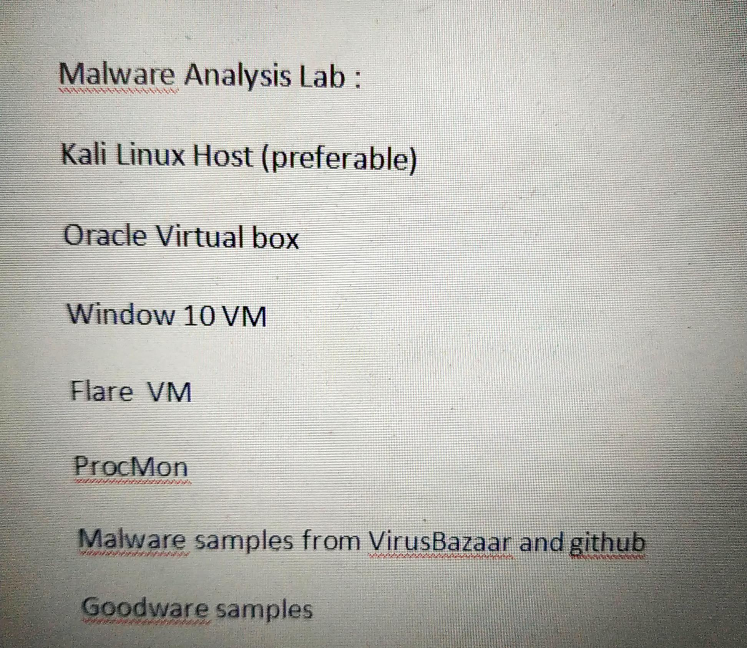
LOG FILE GENERATION

Slide 4

FOR DATA EXTRACTION, MODEL TRAINING AND EVALUATION

Slide 5
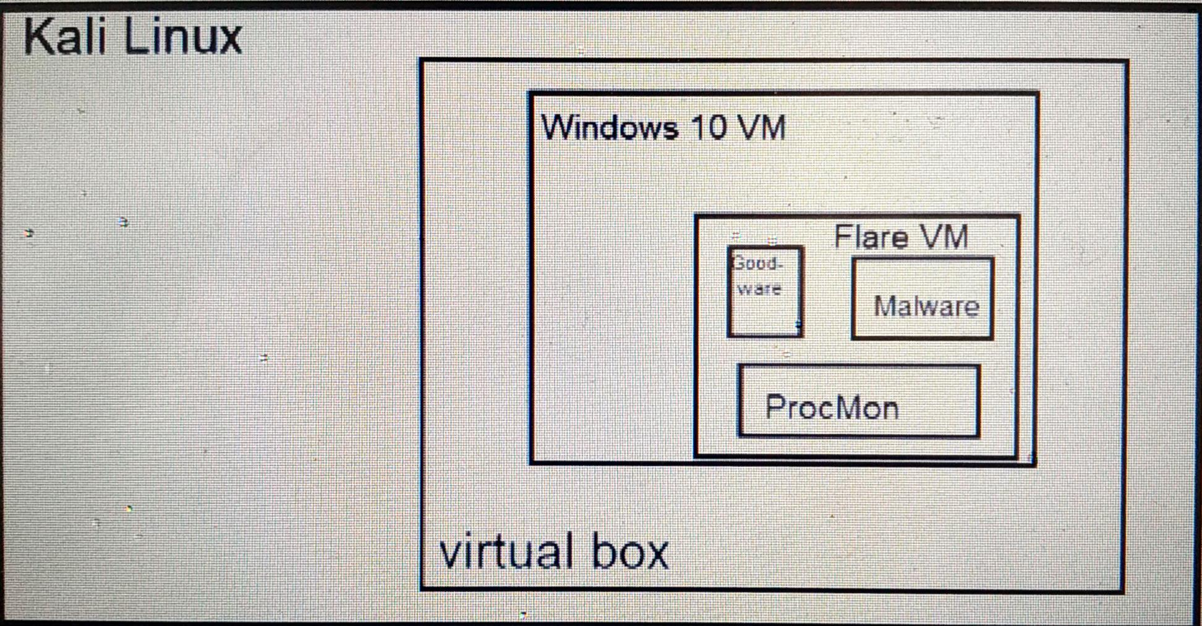
SYSTEM DIAGRAM

Slide 6
Algorithms used :
Decision Trees
Random Forest
Logistic Regression
SVM

Slide 7
WORKFLOW:
Log file generation
Data extraction from log files
Model training
Model evaluation

Slide 8
CONCLUSION

